Slide 1

Reinforced Shock Acceleration of Relativistic Electrons
Savvas Raptis¹, Ahmad Lalti ^{2,3}, Martin Lindberg ^{4,5}, Drew L. Turner ¹, Damiano Caprioli⁶, James L. Burch⁷
¹ APL/JHU, Laurel, MD, USA
² Swedish Institute of Space Physics, Uppsala, Sweden
³ Uppsala University, Uppsala, Sweden
⁴ Division of Space and Plasma Physics — KTH Royal Institute of Technology, Stockholm, Sweden
⁵ Department of Physics and Astronomy, Queen Mary University of London, Mile End Road, London E1 4NS, UK
⁶ Department of Astronomy & Astrophysics and E. Fermi Institute, The University of Chicago, 5640 S Ellis Ave, Chicago, IL 60637, USA
⁷Southwest Research Institute, San Antonio, TX, USA
savvas.raptis@jhuapl.edu / https://savvasraptis.github.io

Slide 2
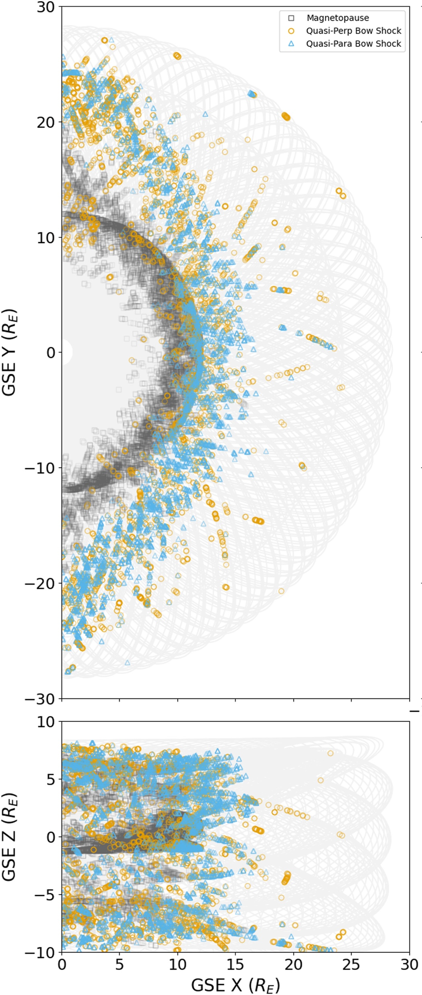
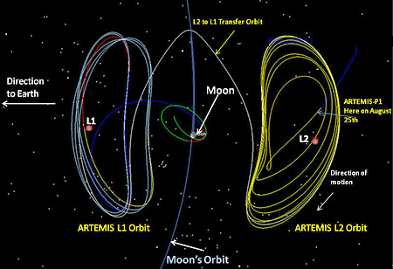
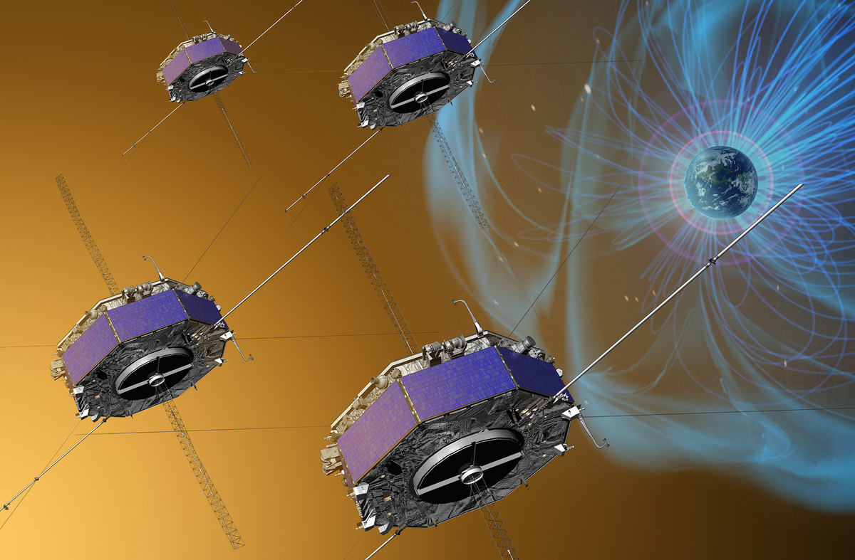
Observational dataset
ARTEMIS/THEMIS
MMS
Launched March 2015
4 identical s/c (10s to 100s km separation)
Equatorial HEO, w/ apogee: ~12 RE (2015-2018); ~28 RE (2018-present
NASA
Toy-Edens+ (2024)
Feb. 17, 2007: Launch → 5 SC
Jan. 1, 2009: THEMIS-P1 and P2 are Reassigned, Renamed and Redirected to the Moon → ARTEMIS
Orbiting the moon it can (sometimes) provide close to Earth in-situ observations of upstream conditions (when moon is on the dayside)
NASA

Slide 3
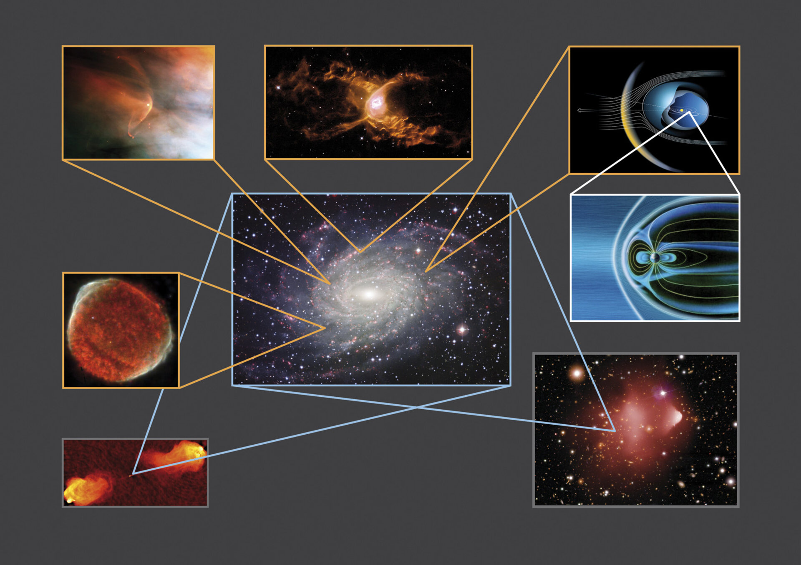
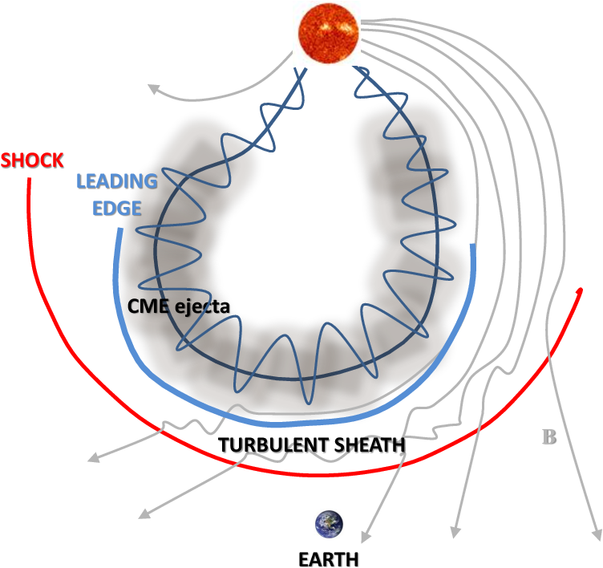
Collisionless Shocks
They are everywhere!
Heating, accelerating particles and converting energies

Slide 4
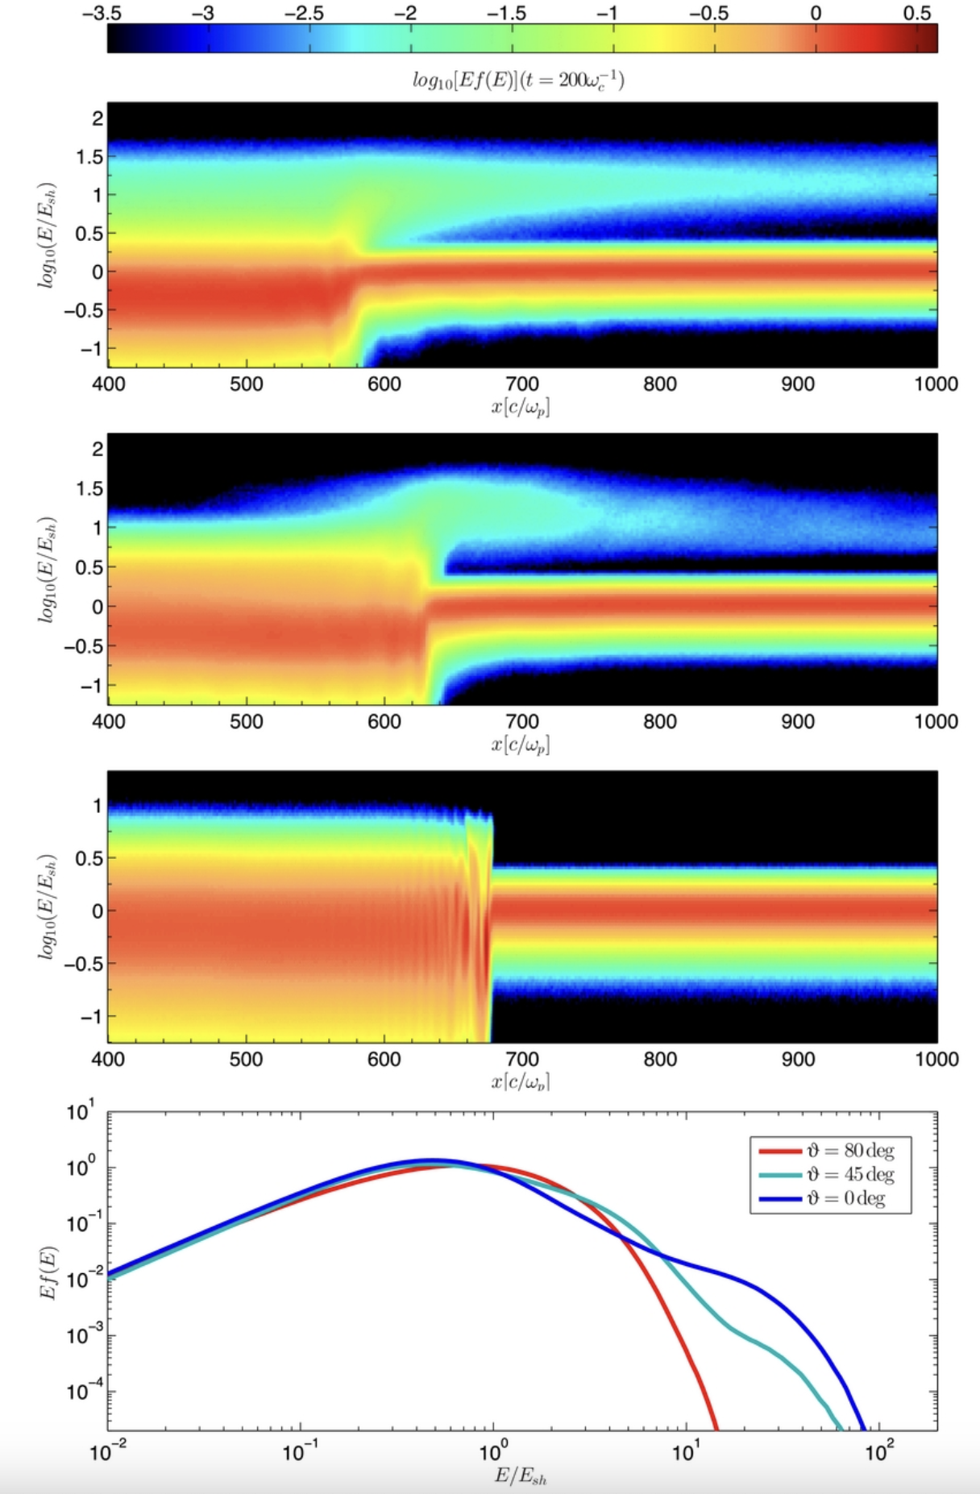
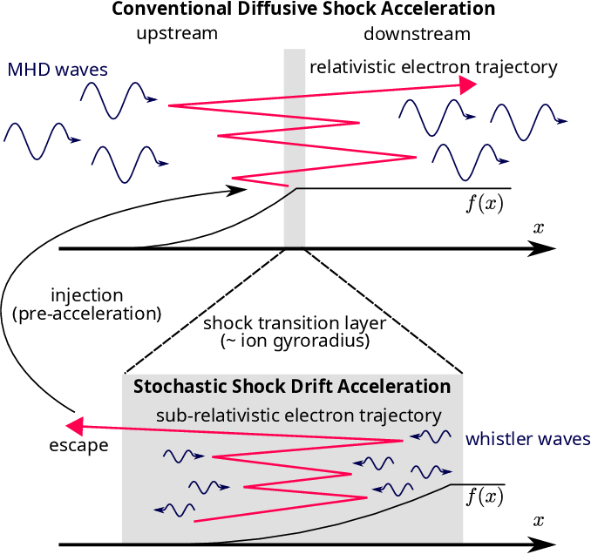
Acceleration at Qpar and Qperp shocks
Qpar shock (DSA)
Oblique shock
Qperp shock
(SDA/SSDA)
ions
Caprioli and Spitkovsky 2014
Amano et al. 2020 | PRL
Notes:
Shock Drift Acceleration = Not enough to get relativistic
Diffusive Shock Acceleration = Good, but requires injection.
SSDA tried to solve this by introducing whistler activity

Slide 5
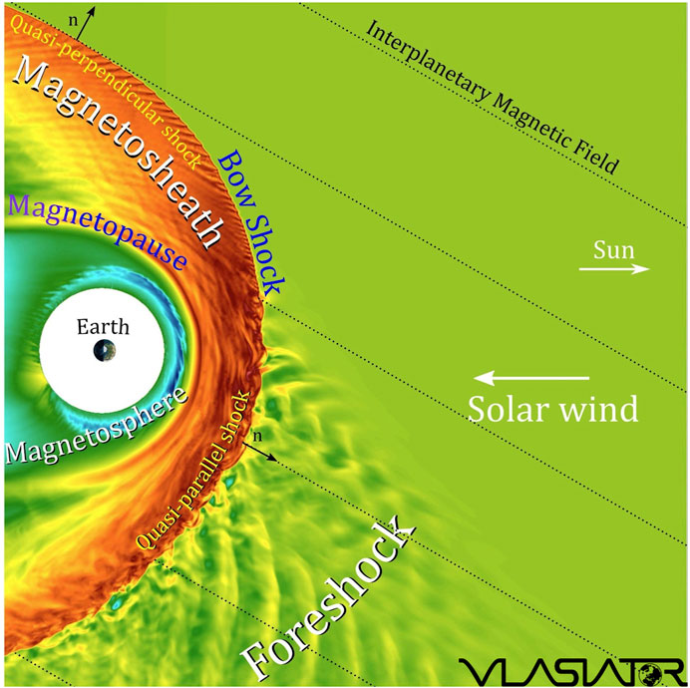
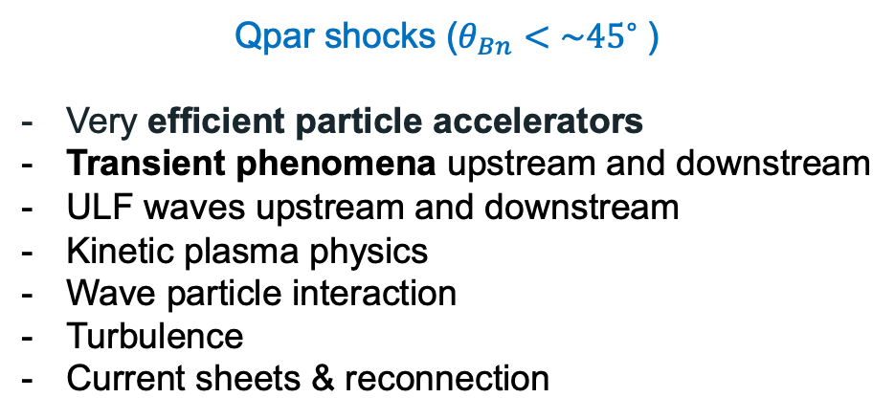
Earth’s Qpar bow shock and foreshock
Qpar shocks ($θ_{Bn}<\sim {45}^{∘}⁡$)
Very efficient particle accelerators
Transient phenomena upstream and downstream
ULF waves upstream and downstream
Kinetic plasma physics
Wave particle interaction
Turbulence
Current sheets & reconnection

Slide 6
Upstream/Foreshock/Dayside/Shock-associated Transients

Slide 7
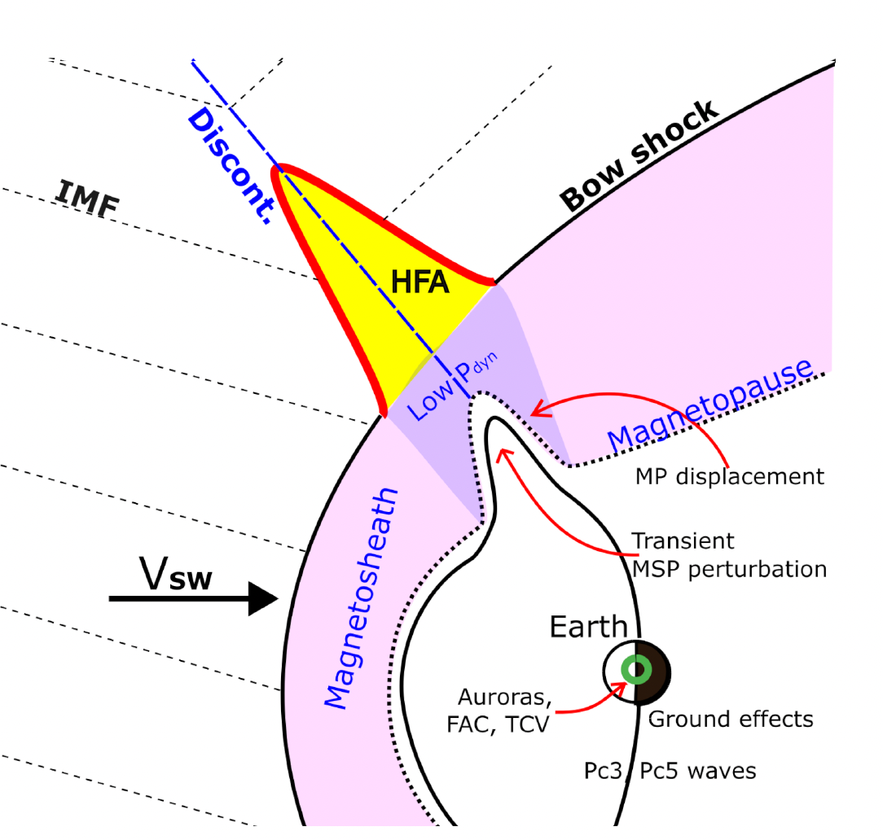
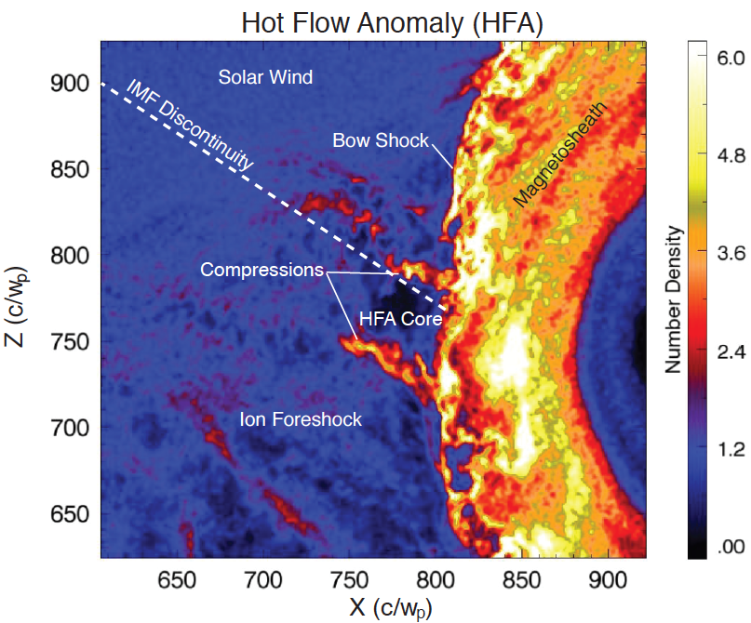
The anatomy of an HFA
Crater-like B-field and IMF discontinuity
Upstream
shock
Solar wind beam disrupted
Density compressions and cavity
Upstream
shock
Strong plasma flow
deflections in core
Hot Flow Anomalies (HFA)
Figure by Nick Omidi
Kajdič+ (2024, under review)
Superheated core plasma
IMF directional discontinuity intersects the bow shock and the convection electric field (−V X B) points towards the sheet on at least one side
Figure by Drew Turner

Slide 8
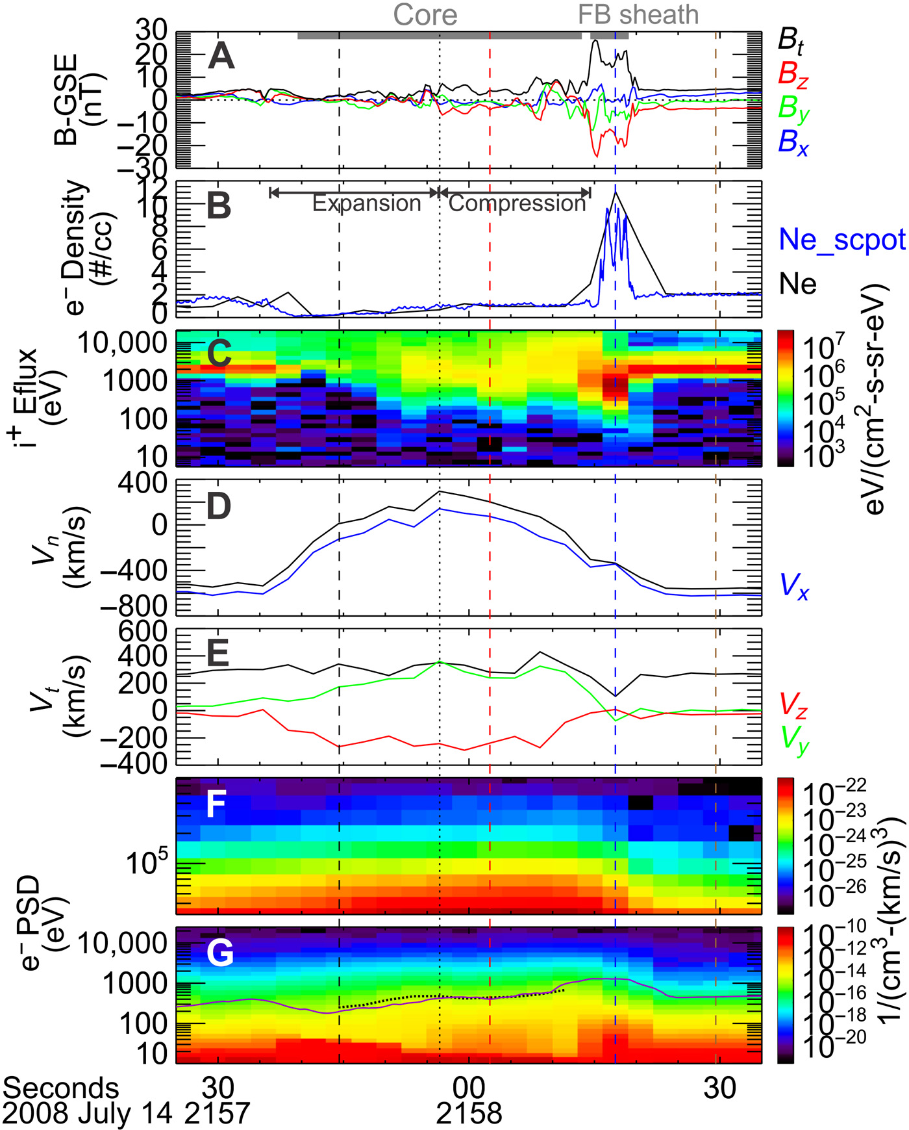
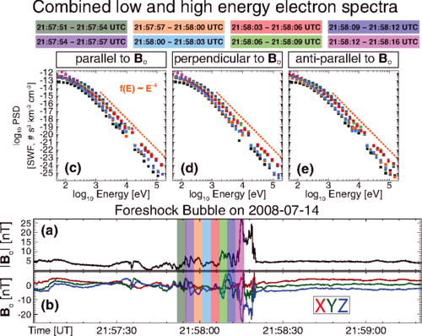
Foreshock Transients & Electron acceleration
~300 KeV
Wilson III L. et al. 2016 | PRL
~200 KeV
Liu T. et al. 2019 | Science Adv.

Slide 9
Results
Quick reminder:
Qpar shocks → DSA is efficient, but how do we solve the injection problem?
Qperp shocks → Significant progress there, (S)SDA is fine, but not necessarily sufficient to drive relativistic energies.
Don’t forget that Qpar shocks include the foreshock and its transients including secondary shocks

Slide 10
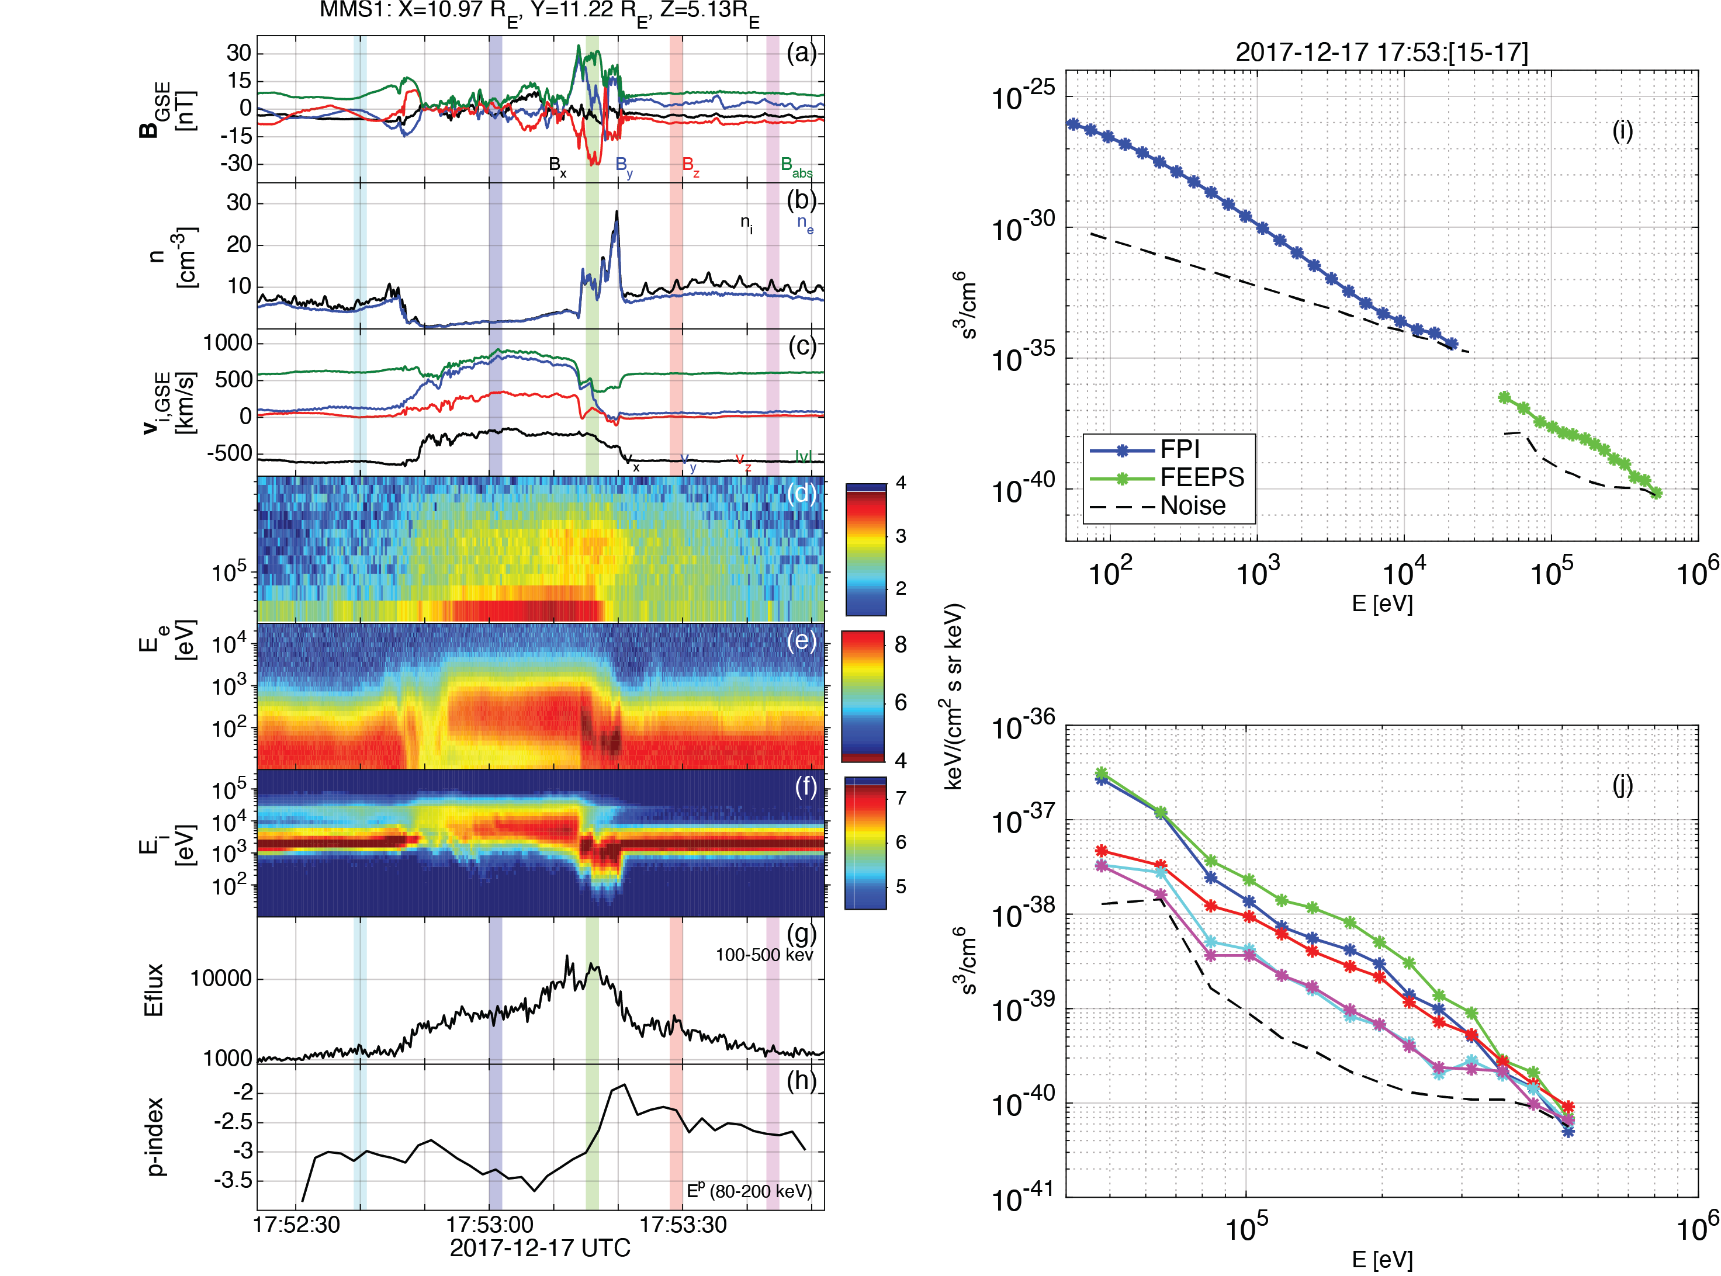
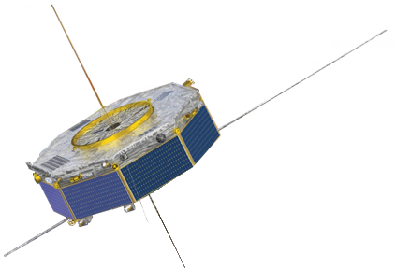

Relativistic Electrons with MMS
Typical properties of transient:
- Depleted Core (low B, n)
- Mature HFA (ΔΒ/B0 ~ 1-4)
- SW beam disrupted
- Strong density and magnetic field compressive boundaries
- Formation of a Qperp “shock”
- Flow anomaly (velocity decreasing)
Unique property
>500 keV electrons throughout the core and shock region
Foreshock transient
Bow shock
Raptis+ 2024 (under review)

Slide 11
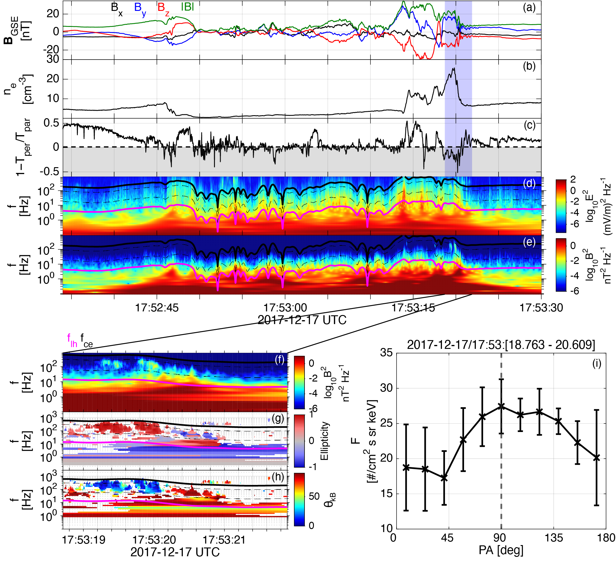
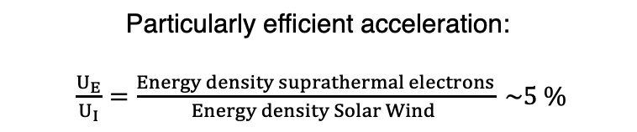
Wave analysis of event
Reminder: This mechanism is NOT exclusive on inner magnetosphere or plasma sheet
Acceleration:
Shock Acceleration
Betatron → Temperature anisotropy
High amplitude electron whistler waves (Chorus) resonance
Scattering & Trapping:
- LF whistler waves (Shock)
- Wavefield of HFA’s core
- Geometry of HFA. i.e., ”Magnetic bottle” between edges of HFA and the Earth’s bow shock
Particularly efficient acceleration:
$\frac{U_{E}}{U_{I}}=\frac{Energy density suprathermal electrons}{Energy density Solar Wind } \sim 5 \%$
Raptis+ 2024 (under review)
See Artemyev+, Xiaofei+, Vargas + Tonoian+ (2022 – 2024)

Slide 12
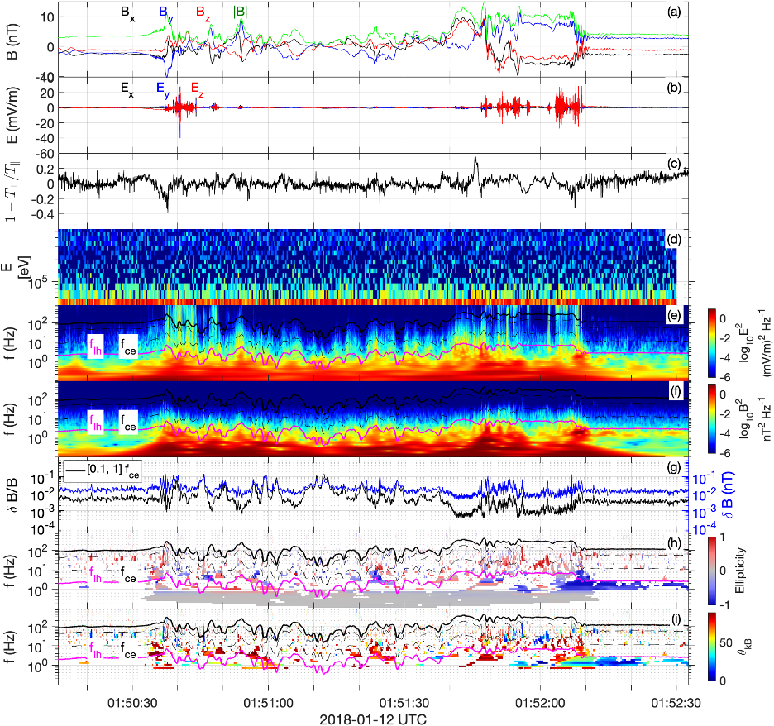
Missing piece of the puzzle? – Let’s look at another event
Waves are there
Shock is there,
All the stuff are there.
FEEPS = no signal
So why not always
relativistic electrons?
Raptis+ 2024 (under review)

Slide 13
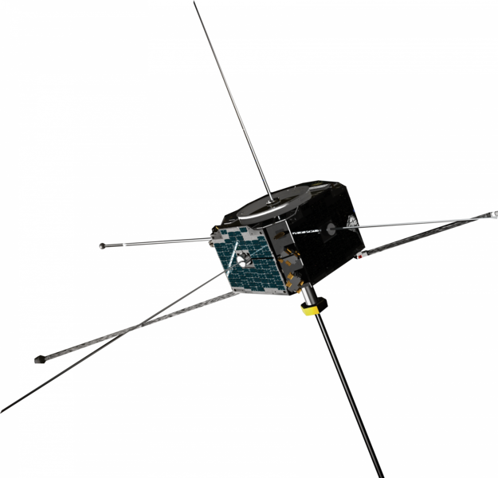
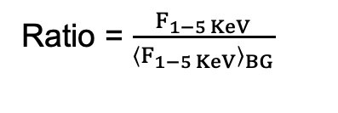
Upstream conditions for two event - ARTEMIS
Ratio = $\frac{F_{1−5 KeV}}{{\left\langle F_{1−5 KeV}\right\rangle }_{BG}}$
FEEPS: 100+ KeV
No Signal at FEEPS
Discontinuity ARTEMIS
Transient MMS
Earth
Raptis+ 2024 (under review)
~ 30 Re

Slide 14
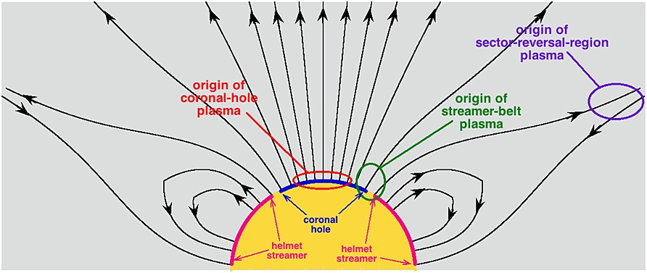
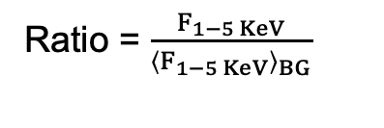
Statistics for seed and acceleration
Seed events (FEEPS > 100 KeV)
CH (78%), CH (40%), CH(79%), CH (39%), CH(77%), CH(79%)
No-seed (FEEPS = Noise)
SB (80%), SB(42%), EJ (55%) SB (44%), SR(63%), SB (46%)
Using: [Xu and Borosvky 2014, Camporeale+ 2017] methodology
Ratio = $\frac{F_{1−5 KeV}}{{\left\langle F_{1−5 KeV}\right\rangle }_{BG}}$
Raptis+ 2024 (under review)
Terry Liu+ ( 2017) noticed similar trends

Slide 15
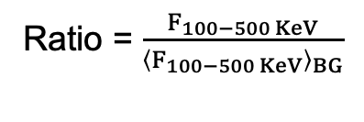
Reinforced Shock Acceleration
Electron acceleration
Shock Acceleration
Wave particle interactions
Ratio = $\frac{F_{100−500 KeV}}{{\left\langle F_{100−500 KeV}\right\rangle }_{BG}}$
Seeding
Injection Threshold
Seed from
CH plasma
(1-5 keV)
+
Max flux ratio
Efficient through PA scattering & confinement:
- LF whistler waves (Shock Transition)
- Wavefield of HFA’s core (ΔB>>B)
- ”Magnetic bottle” between edges of HFA and Earth’s bow shock (geometry)
- Betatron (electron acceleration temperature anisotropy)
Key-point:
Seed + Foreshock’s Shock + Waves + Efficiency factors = ~MeV electrons before reaching the bow shock.
Raptis+ 2024 (under review)

Slide 16
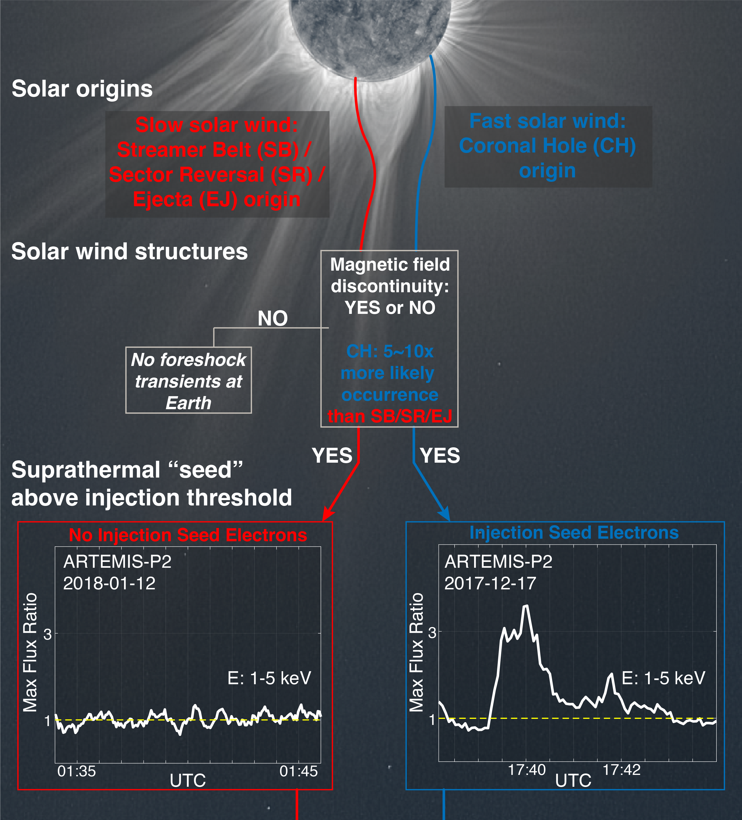
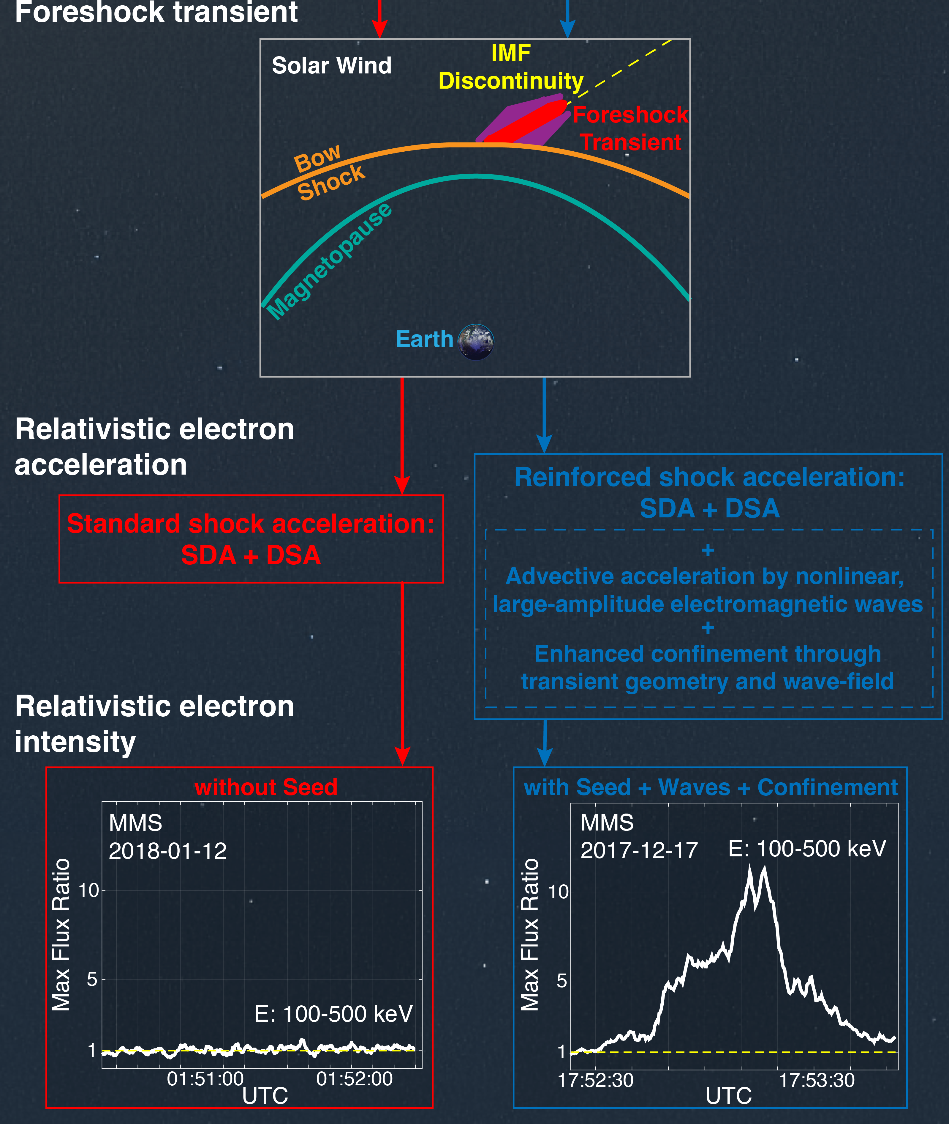
Schematic of the process
(a)
(b)
Raptis+ 2024 (under review)

Slide 17
Summary & Conclusion
Plasma Observatory
Combining multi-scale processes across a quasi-parallel shock we formulated a reinforced shock acceleration for relativistic electrons.
Revealed that the electron injection threshold at Earth to be at the suprathermal range of ~1-5 KeV
This seed population is a systematic feature of the fast solar wind/coronal hole plasma.
Discussion: Potentially a generalized processes in other planetary environments of stellar systems allowing particles to reach energies from MeV to Gev+ levels
AGU Session (Abstracts are open!): SH004 - Collisionless Shocks in Heliospheric and Astrophysical Plasmas and their Effects on Planetary Magnetospheres
Bonus: Already promising observations downstream of a planetary bow shock. I will be glad to discuss/collaborate with these who are interested in the near future

Slide 18
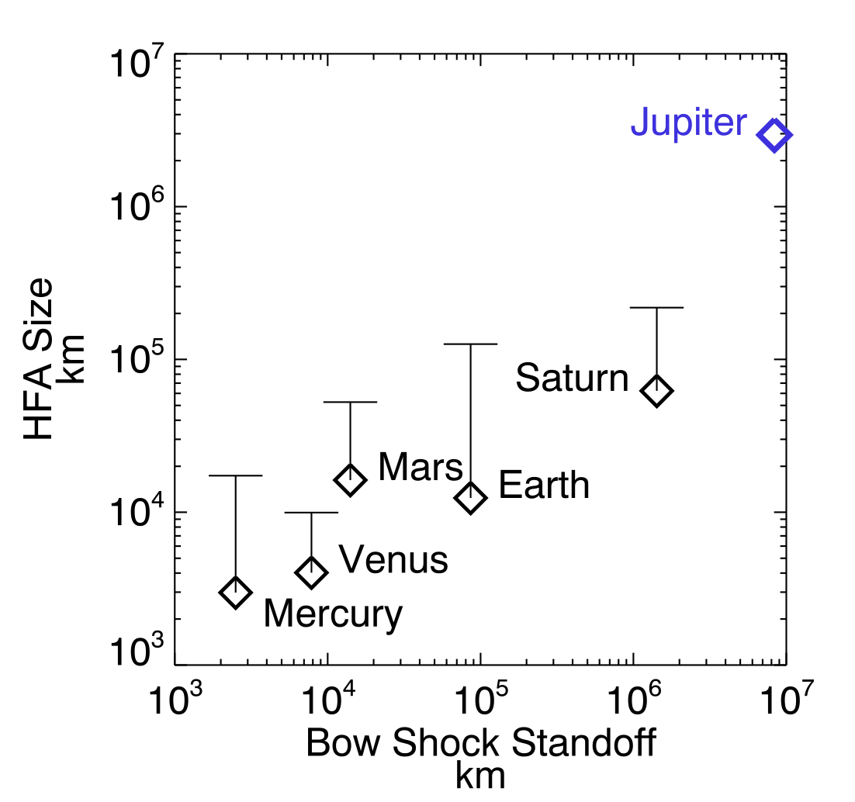
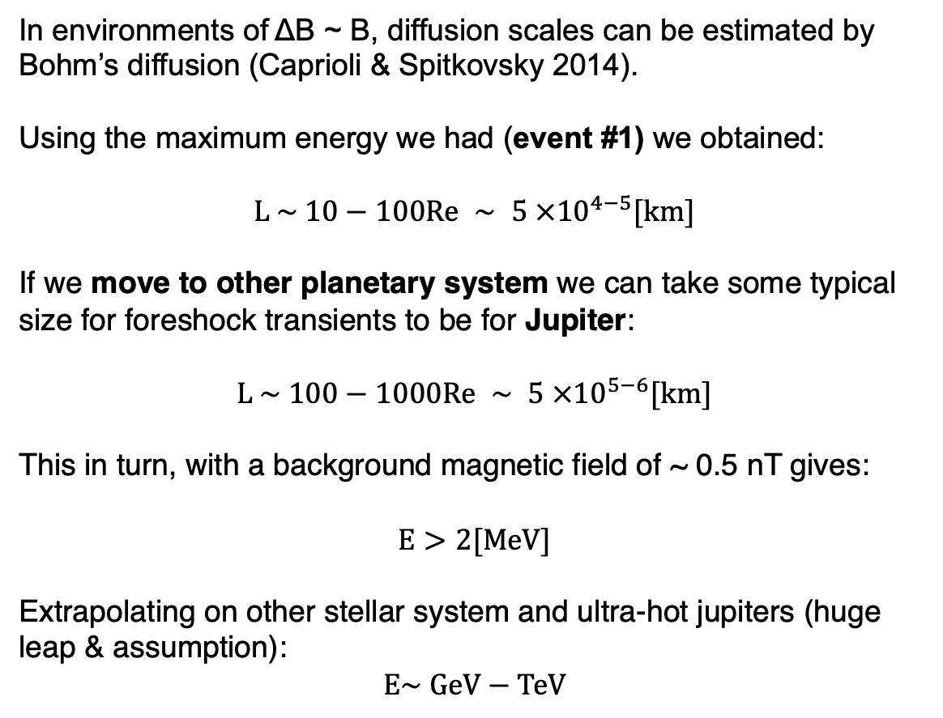
Electron Acceleration in other systems
In environments of ΔB ~ B, diffusion scales can be estimated by Bohm’s diffusion (Caprioli & Spitkovsky 2014).
Using the maximum energy we had (event #1) we obtained:
$$L \sim 10−100Re ∼ 5 ×{10}^{4−5}[km]$$
If we move to other planetary system we can take some typical size for foreshock transients to be for Jupiter:
$$L \sim 100−1000Re ∼ 5 ×{10}^{5−6}[km]$$
This in turn, with a background magnetic field of ~ 0.5 nT gives:
$$E>2[MeV]$$
Extrapolating on other stellar system and ultra-hot jupiters (huge leap & assumption):
$$E\sim GeV−TeV$$
Valek + 2017
Notes:
Ultrahot Jupiter $B∼0.01 − 1G ∼ {10}^{3−5} nT$

Slide 19
Extras

Slide 20
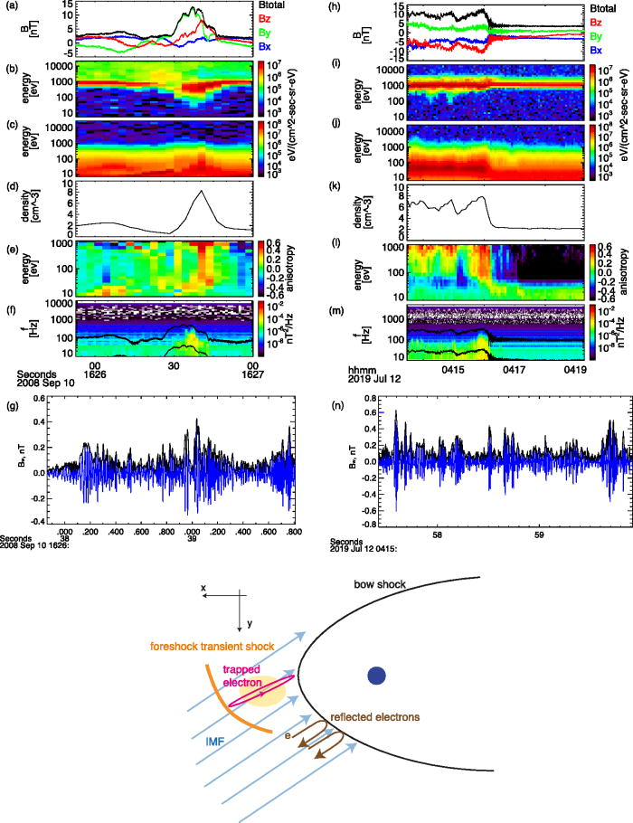
Recent updates – Wave Particle Interactions
Foreshock transient
Bow shock crossing
Xiaofei+ (2023)
Adiabatic heating
Temperature Anisotropy
High frequency whistlers
Electron acceleration + pitch angle scattering
Reminder: This mechanism is NOT exclusive on inner magnetosphere or plasma sheet
See Artemyev+, Xiaofei+, Vargas + Tonoian+ (2022 – 2024)

Slide 21

Discussing new models
*
*In our case models, mechanisms, explanations etc.

Slide 22
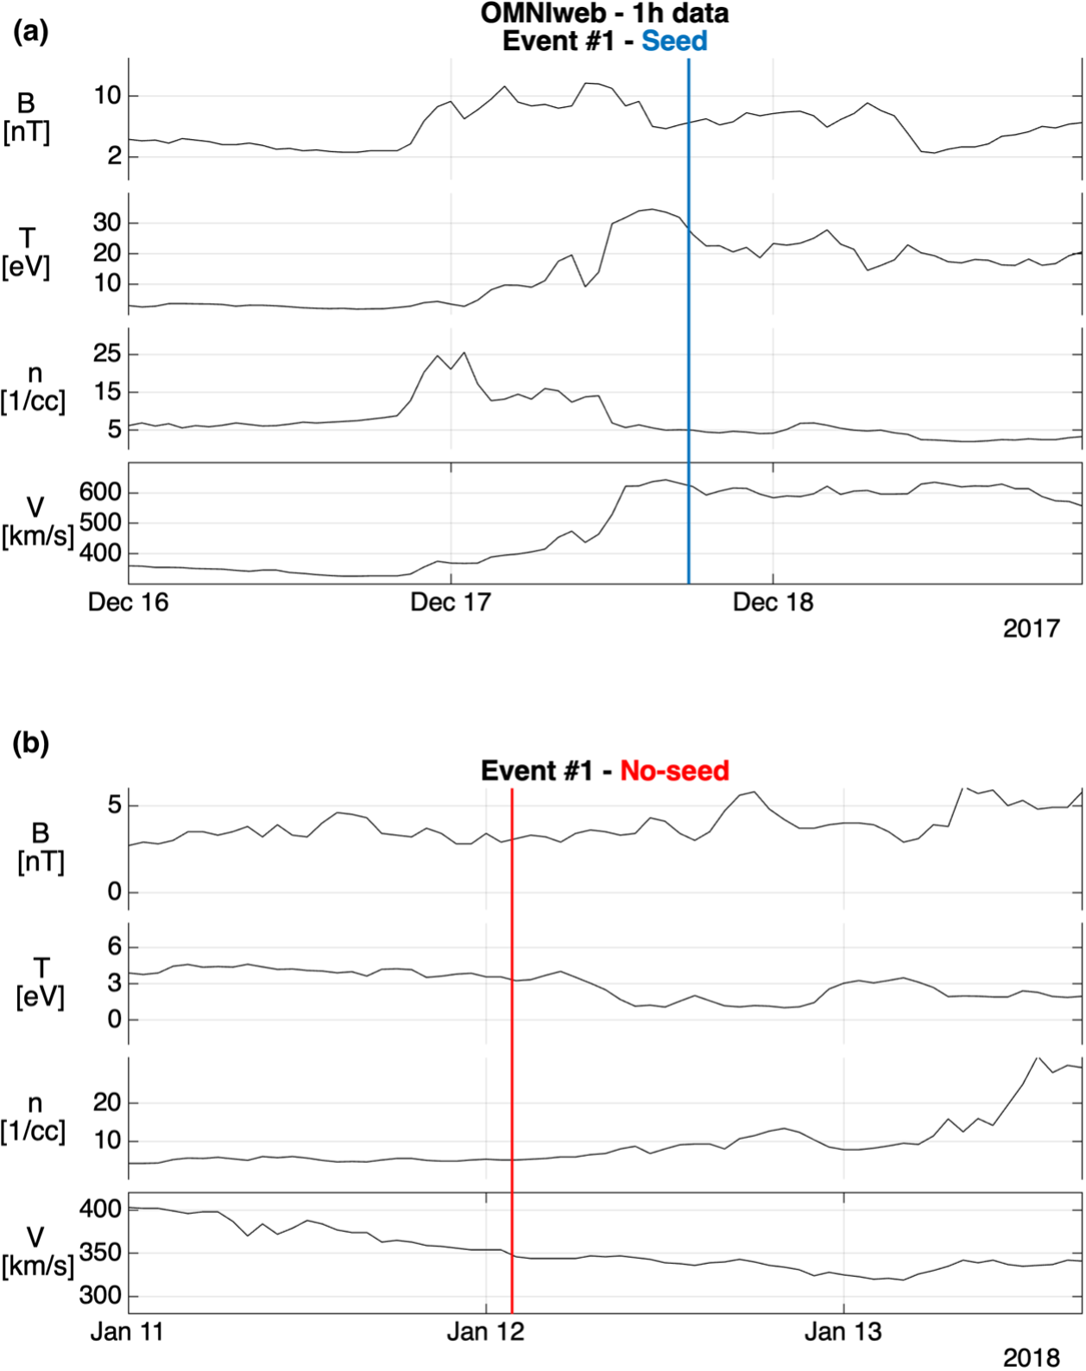
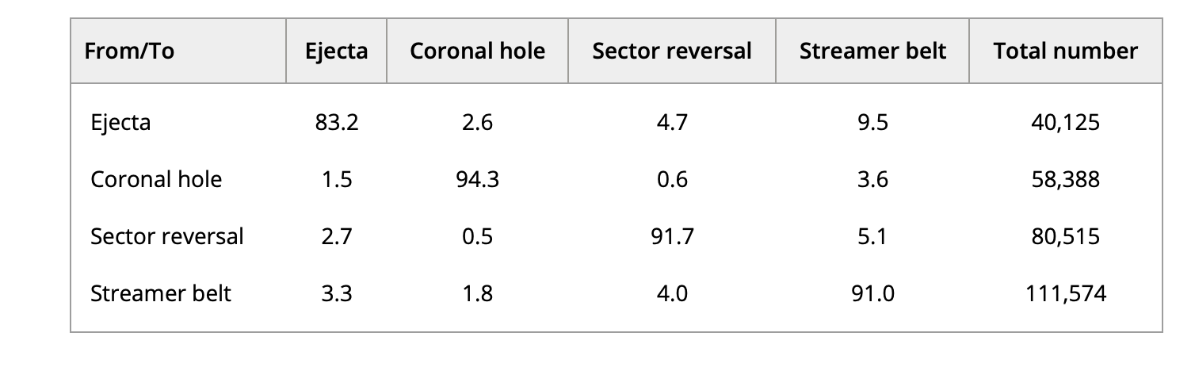
Seed population - larger context
OMNI 1-h data set (1965–2017)
Xu and Borosvky 2014 = 4 classes (Ejectra, Coronal Hole, Sector Reversal, Streamer Belt)
Camporeale at al. 2017 = ML method for nowcasting (OMNI 1h data)
Unpublished = Expanded until 2023 & to OMNI 1min data
Notes:
Input: the solar wind speed V_{sw}, the temperature standard deviation σ_{T}, the sunspot number R, the F_{10.7} index, the Alfven speed v_{A}, the proton specific entropy S_{p}, and the proton temperature T_{p} compared to a velocity-dependent expected temperature.

Slide 23
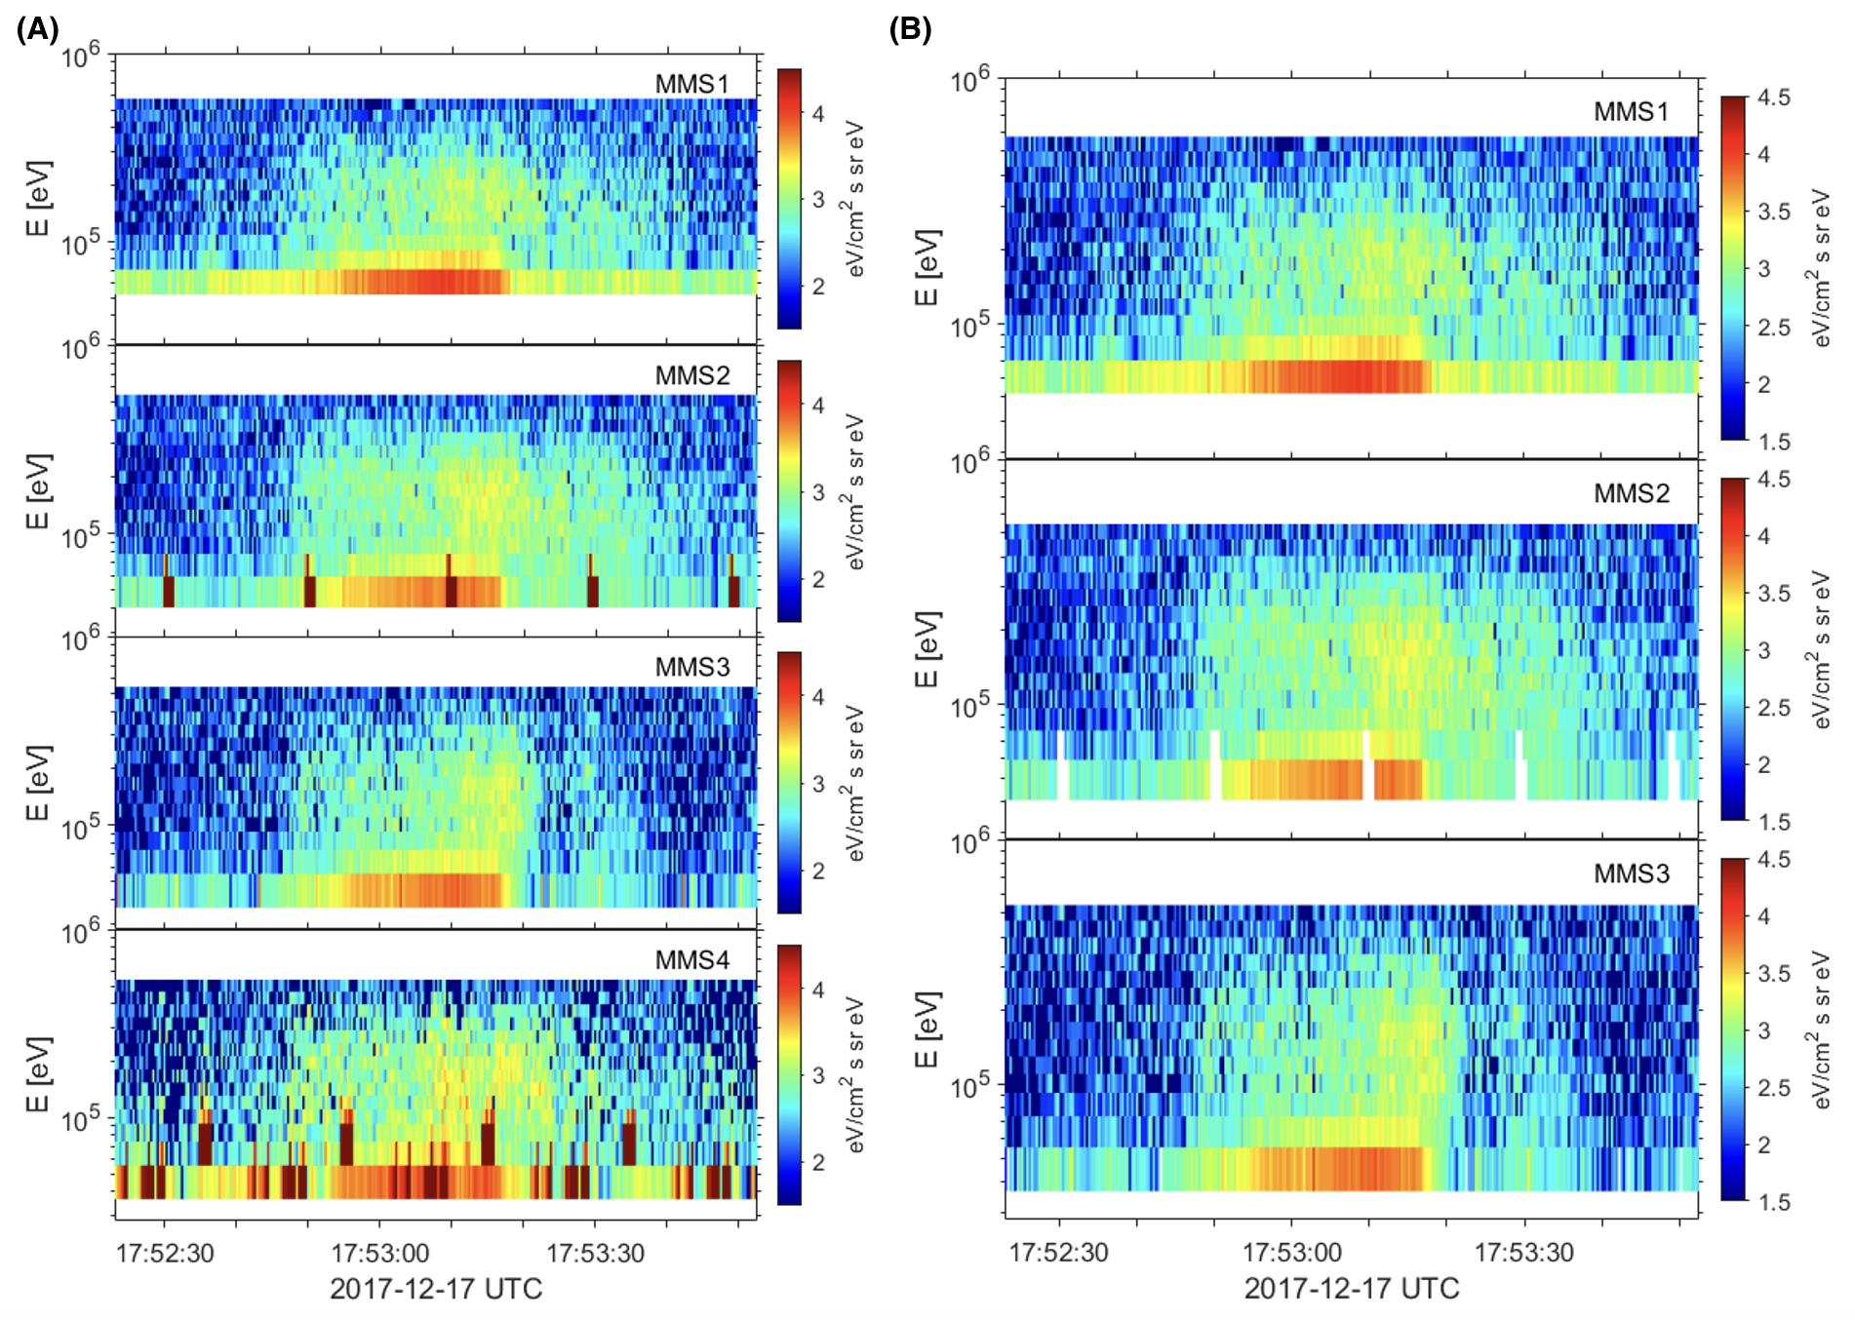
FEEPS post processing
MMS 1-3 FEEPS

Slide 24
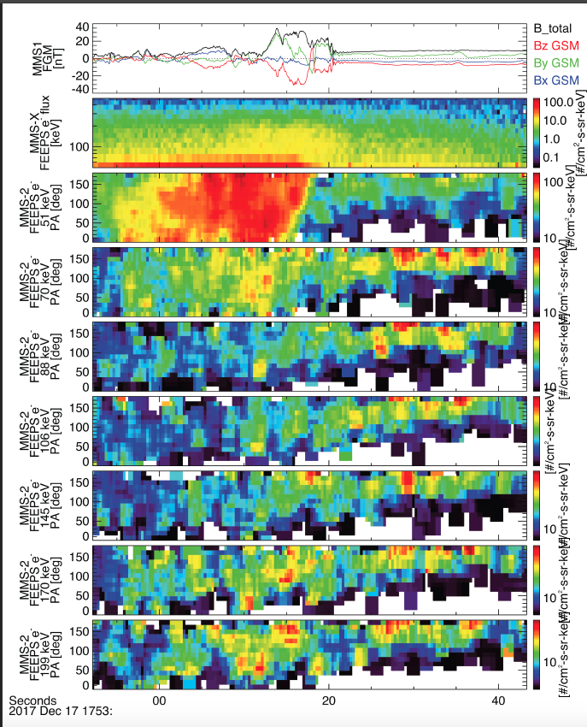
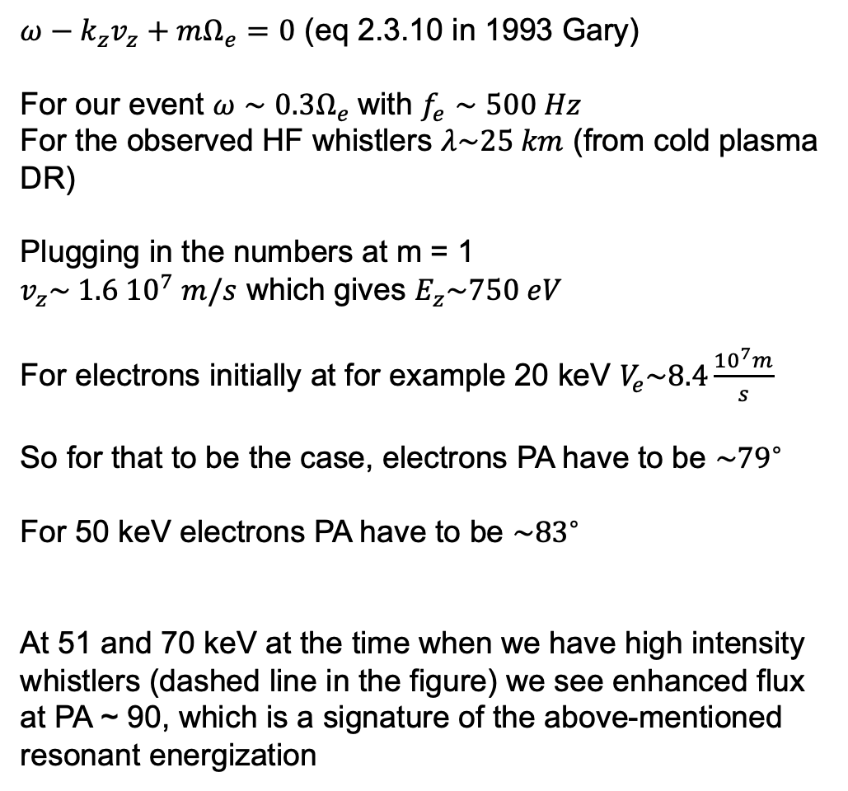
Wave-particle interaction
$ω−k_{z}v_{z}+mΩ_{e}=0$ (eq 2.3.10 in 1993 Gary)
For our event $ω∼0.3Ω_{e}$with $f_{e}∼500 Hz$
For the observed HF whistlers $λ\sim 25 km$ (from cold plasma DR)
Plugging in the numbers at m = 1
$v_{z}\sim 1.6 {10}^{7} m/s$ which gives $E_{z}\sim 750 eV$
For electrons initially at for example 20 keV $V_{e}\sim 8.4\frac{{10}^{7}m}{s}$
So for that to be the case, electrons PA have to be $\sim {79}^{∘}$
For 50 keV electrons PA have to be $\sim {83}^{∘}$
At 51 and 70 keV at the time when we have high intensity whistlers (dashed line in the figure) we see enhanced flux at PA ~ 90, which is a signature of the above-mentioned resonant energization

Slide 25
Is seed from the foreshock? – Maybe partially
(A), (B) → Seeded events – partial mode
(C) → Seeded event full mode
(D) → Non-seeded event – partial mode
3/6 seeded and 2/6 non seeded connected to foreshock

